Slide 1
Unit 04 Descriptive Statistics in R Prof. Gaurav Kulkarni

Slide 2
Descriptive Statistics of Datasets
Descriptive statistics are brief descriptive coefficients that summarize a given data set, which can be either a representation of the entire or a sample of a population. Descriptive statistics can be measured through central tendency and variability (spread).
Measures of central tendency include the mean, median and mode.
Measures of variability include standard deviation, variance, minimum and maximum variables, and kurtosis and skewness.
Thus descriptive statistics helps to summarize and derive meaning from your data.
Descriptive statistics is used mainly to give a description of the behavior of the sample data. Descriptive statistics are usually used in presenting a quantitative analysis of data in a simple way.

Slide 3
Measures of Central Tendency
Central Tendency is one of the feature of descriptive statistics. Central tendency tells about how the group of data is clustered around the centre value of the distribution. Central tendency performs the following measures:
Arithmetic Mean
Geometric Mean
Harmonic Mean
Median
Mode

Slide 4
Arithmetic Mean
The arithmetic mean is simply called the average of the numbers which represents the central value of the data distribution. It is calculated by adding all the values and then dividing by the total number of observations.
In R language, arithmetic mean can be calculated by mean() function.
Syntax: mean(x, trim, na.rm = FALSE)
Parameters: x: Represents object trim: Specifies number of values to be removed from each side of object before calculating the mean. The value is between 0 to 0.5 na.rm: If TRUE then removes the NA value from x

Slide 5
Arithmetic Mean
The mean of a set of observations is an average. You simply add up all the values and then divide by the total number of values. If we were to compute the mean for cars$speed (or the variable speed our dataset called cars) we would simply sum the values in the column for speed and divide by 50.
(4 + 4 + 7 + 7 + 8 + 9 + 10 + 10 + 10 + 11 + 11 + 12 + 12 + 12 + 12 + 13 + 13 + 13 + 13 + 14 + 14 + 14 + 14 + 15 + 15 + 15 + 16 + 16 + 17 + 17 + 17 + 18 + 18 + 18 + 18 + 19 + 19 + 19 + 20 + 20 + 20 + 20 + 20 + 22 + 23 + 24 + 24 + 24 + 24 + 25) / 50
Or quite simply: 770/50 = 15.4
In R, we can compute the mean in several ways:
sumofspeed <- sum(cars$speed)
sumofspeed / 50or
sum(cars$speed) / length(cars$speed)
## [1] 15.4 or simply using the mean function
mean(cars$speed)
## [1] 15.4

Slide 6

Geometric Mean
The geometric mean is a type of mean that is computed by multiplying all the data values and thus, shows the central tendency for given data distribution.
where
X indicates geometric mean indicates value in data vector n indicates total number of observations
prod() and length() function helps in finding the geometric mean for given set of numbers as there is no direct function for geometric mean.
Syntax:
prod(x)^(1/length(x)) where, prod() function returns the product of all values present in vector x length() function returns the length of vector x

Slide 7
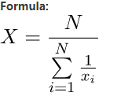
Harmonic Mean
Harmonic mean is another type of mean used as another measure of central tendency. It is computed as reciprocal of the arithmetic mean of reciprocals of the given set of values.
Formula:
where,
X indicates harmonic mean indicates value in data vector n indicates total number of observations

Slide 8
The median
The median is another measure of central tendency. The middle value in a set of observations is the median. For cars$speed, we can sort our variables in ascending order using the sort function. This can help us identify the median.
sort(cars$speed)## [1] 4 4 7 7 8 9 10 10 10 11 11 12 12 12 12 13 13 13 13 14 14 14 14 ## [24] 15 15 15 16 16 17 17 17 18 18 18 18 19 19 19 20 20 20 20 20 22 23 24 ## [47] 24 24 24 25
In this case, the middle value is at positions 25 and 26. The middle value is 15. If the value of position 25 was 14 and the value of position 26 was 15 we’d take the average of the two values and the median would be 14.5.
An easier way to compute the median is to use the median( ) function:
median(cars$speed)
## [1] 15

Slide 9
The mode
The mode of a set of observations is the value that occurs most frequently. There’s not a standard function in R that computes the mode. However, you can create a simple frequency table to tally the number of times each value occurs.
table(cars$speed)
## ## 4 7 8 9 10 11 12 13 14 15 16 17 18 19 20 22 23 24 25
## 2 2 1 1 3 2 4 4 4 3 2 3 4 3 5 1 1 4 1
Here we see that the value 20 occurs 5 times.
You can also compute the mode using the following algorithm:
modeforcars<-table(as.vector(cars$speed)) names(modeforcars)[modeforcars == max(modeforcars)]
## [1] “20”

Slide 10
The median
More likely than not, in your daily life you’ll be working with data that is messy. For example, you may have a dataset that looks something like
-100, 2, 4, 6, 8, 10, 12, 14, 16
Just by looking at this data you can tell that something may be wrong with it. The -100 values looks off. Chances are that -100 is probably an outlier. An outlier is a value that lies well outside most of the other values in a set of data. In this case, you may want to remove the value from your set of data entirely.

Slide 11
The median
myvector_outlier<- c(-100, 2, 4, 6, 8, 10, 12, 14, 16) mean(myvector_outlier[2:9])
## [1] 9
However, even this example is an oversimplification of what you may experience. There may be cases where you may have data that looks just a little off. In the set of data below, -15 could be a legitimate value or it could be a typo or outlier.
Take this set of data: -15, 2, 3, 4, 5, 6, 7, 8, 9, 12
myvector_trim<- c(-15, 2, 3, 4, 5, 6, 7, 8, 9, 12) mean(myvector_trim)
## [1] 4.1mean(myvector_trim, trim=.1)
## [1] 5.5By trimming the upper and lower 10% of values, you can see the difference in the mean from 4.1 (without trimming) to 5.5 (with trimming).

Slide 12
Measures of Variability
Variability is the extent to which data points in a statistical distribution or data set diverge from the average, or mean, value as well as the extent to which these data points differ from each other.
There are four commonly used measures of variability: range, mean, variance and standard deviation.
In addition to computing measures of central tendency, another summary statistic we’d like to compute is variability. How spread out are the data? How far from the mean and median do the observed values tend to be?

Slide 13
Range
The range of a variable is the largest value minus the smallest value. We can compute the largest value using the max function and the smallest value using the min function. In the case with cars$speed, the range is 25 – 4 or 21.
min(cars$speed)
## [1] 4
max(cars$speed)
## [1] 25
R has an even better function, range that outputs the minimum and maximum value in a vector
range(cars$speed)
## [1] 4 25

Slide 14
Interquartile range
The interquartile range is similar to the range, but instead of calculating the difference between the biggest and smallest value, you calculate the difference between the 25th quantile and the 75th quantile.
In simple terms, a quantile is where a sample is divided into equal-sized, adjacent, subgroups (that's why it's sometimes called a “fractile“). It can also refer to dividing a probability distribution into areas of equal probability. ... Quartiles are also quantiles; they divide the distribution into four equal parts
We can calculate the interquartile range (IQR) using IQR. This is the range spanned by the middle half of the data. For example this is the 75th quantile minus the 25th quantile.
IQR(cars$speed)
## [1] 7We can see all quantiles by typing the following:
quantile(cars$speed)
## 0% 25% 50% 75% 100%
## 4 12 15 19 25 Or just to see the 25% and 75% we can type:
quantile(cars$speed, probs=c(.25, .75))
## 25% 75%
## 12 19Therefore, you can see the IQR is simply 19 – 12.

Slide 15

Variance
The variance is a numerical measure of how the data values are dispersed around the mean. The variance measures how far a set of numbers are spread out. (A variance of zero indicates that all the values are identical.)
A non-zero variance is always positive: A small variance indicates that the data points tend to be very close to the mean (expected value). A high variance indicates that the data points are very spread out from the mean and from each other.
The variance of a dataset X is sometimes written as Var(X) but more commonly denoted as s² for a given sample. The formula for the sample variance is:
S^2= Sample Variance xi= value of one observation
X= mean value of all observation n= number of observation
To compute the sample variance in R we would type the following:
var(cars$speed)
## [1] 27.95918

Slide 16
Standard deviation
The square root of the variance is the standard deviation. Below is the formula for the sample standard deviation.
s=√s2
To compute the sample standard deviation in R, type the following:
sqrt(var(cars$speed))
## [1] 5.287644or you can use the sd function
sd(cars$speed)
## [1] 5.287644

Slide 17
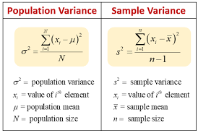

Slide 18
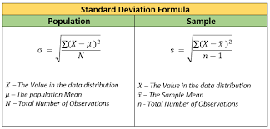

Slide 19
Skew
Skewness is a measure of symmetry. If there are more extremely large values than extremely small ones, the data can be described as positively skewed.
If the data tend to have a lot of extreme small values and not many extremely large values then the data is considered negatively skewed.
As a rule, negative skewness indicates that the mean of the data values is less than the median, and the data distribution is left-skewed.
Positive skewness would indicate that the mean of the data values is larger than the median, and the data distribution is right-skewed.

Slide 20
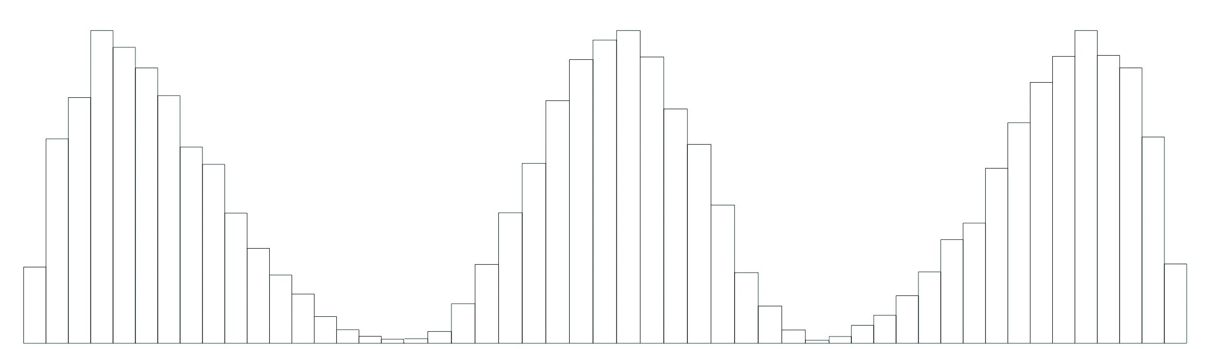
Positive skew No skew Negative skew

Slide 21
Skew
We can compute the skew by using a function called skew( ) from the psych package.
library(psych)
skew(cars$speed)
## [1] -0.1105533

Slide 22
Kurtosis
Kurtosis is the measure of the pointiness of the data. The kurtosis is a measure of the peakedness of the data distribution.
We can see how fat or thin the tails of a distribution are relative to a normal distribution. Negative kurtosis would indicates a flat data distribution, which is said to be platykurtic.
Positive kurtosis would indicates a peaked distribution, which is said to be leptokurtic. Incidentally, the normal distribution has zero kurtosis, and is said to be mesokurtic.

Slide 23
Kurtosis
We can compute the kurtosis by using a function called kurtosi( ) from the psych package. First install psych package and then use this function.
kurtosi(cars$speed)
## [1] -0.6730924

Slide 24
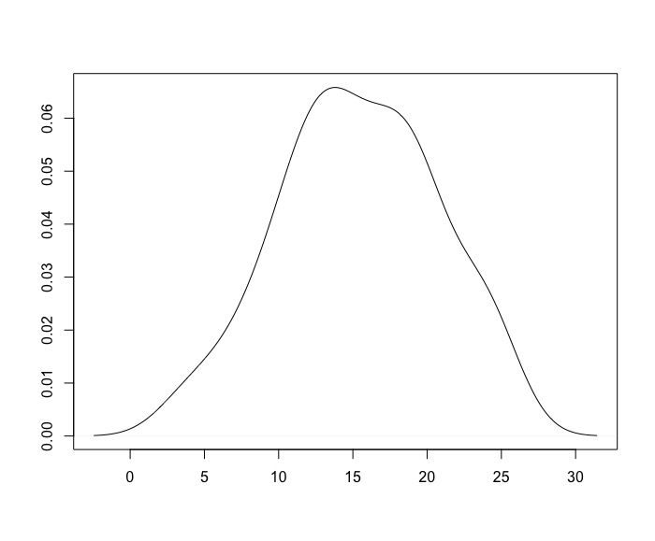

Slide 25
Describe and Summary functions
There’s an easier way to compute some measures of central tendency and variability using the summary( ) function. The summary function provides the min( ), max( ), median( ), mean( ), the 75% and 25% quantiles. To compute all these measures for a single variable type:
Syntax-summary(column name of a dataset/vector/dataframe)
summary(cars$speed)
## Min. 1st Qu. Median Mean 3rd Qu. Max.
## 4.0 12.0 15.0 15.4 19.0 25.0

Slide 26
Summary a data frame
summary(cars)
## speed dist
## Min. : 4.0 Min. : 2.00
## 1st Qu.:12.0 1st Qu.: 26.00
## Median :15.0 Median : 36.00
## Mean :15.4 Mean : 42.98
## 3rd Qu.:19.0 3rd Qu.: 56.00
## Max. :25.0 Max. :120.00

Slide 27
Describing a data frame
A similar function to the summary() function is the describe() function in the psych package. This function is useful when your data are interval or ratio scale.
Unlike the summary() function, it calculates the descriptive statistics for any type of variable you give it.
It also includes other measures that we discussed earlier such as the trimmed mean (default is 10%), skew, kurtosis, and range. n is the sample size (or the number of non missing values)
Syntax-describe(dataframename)
describe(cars)

Slide 28
Describe By function
There are more advanced functions to compute descriptive statistics by group using the psych package. One such function is describeBy().
You can specify a grouping variable. Let’s say we wanted to obtain descriptive statistics separately for each grouping of data.
For example, we could group our data by the different speeds in cars. We could use speed as our grouping variable as follows:
Syntax=describeBy(dataframename,group=condition)
describeBy(cars, group=cars$speed)

Slide 29
Correlations
Aside from looking at the characteristics of our variables, we may want to see if there is a relationship between our variables in our data, or a correlation.
cor(cars$speed, cars$dist)
## [1] 0.8068949

Slide 30
Correlations
Correlation shows the strength of a relationship between two variables and is expressed numerically by the correlation coefficient.
The correlation coefficient's values range between -1.0 and 1.0.
A perfect positive correlation means that the correlation coefficient is exactly 1.
This implies that as one security moves, either up or down, the other security moves in lockstep, in the same direction.
A perfect negative correlation means that two assets move in opposite directions, while a zero correlation implies no linear relationship at all.

Slide 31
Correlations
You can also use the cor( ) function to calculate a complete correlation matrix between all pairs of variables in the data frame.
Syntax-cor(dataframe name)
cor(cars)
## speed dist
## speed 1.0000000 0.8068949
## dist 0.8068949 1.0000000

Slide 32
Correlations
For relationships that may not be linear, you can use Spearman’s rank correlations in the following way:
cor(x,y, method="spearman")

Slide 33
Summary
The most commonly used measures of central tendency are the mean, median and the mode, in addition to the trimmed mean.
The mean of a set of observations is just an average.
The median in a set of observations is the middle value.
The mode of a set of observations is the value that occurs most frequently.
The range of a variable is the larger value minus the smallest value.
The variance is a numerical measure of how the data values is dispersed around the mean.
The square root of the variance is the standard deviation
Interquartile range is the difference between the 25th quantile and the 75th quantile.
Skewness is a measure of symmetry.
Kurtosis is a measure of the peakedness of the data distribution
Correlations are used to determine the relationship between our variables in our data

Slide 34
R Commands
mean( ) computes the arithmetic mean for a set of observations
sort( ) sorts your data in ascending order
median( ) computes the middle value in a set of values
table( ) is used to create a frequency table
max( ) and min( ) are used to compute the range of a variable
mean(x, trim=) pass in the trim parameter to trim the mean( )
range( ) outputs the minimum and maximum value in a vector
quantile( ) produces sample quantiles corresponding to the given probabilities.
IRQ( ) is the range spanned by the middle half of the data.
var( ) is used to compute the variance of a sample
sd( ) is used to compute the standard deviation of a sample
summary( ) produces summary statistics for a variable or data frame.

Slide 35
R Commands
describe( ) produces detailed summary statistics for a variable or data frame
describeBy( ) is used for grouping summary statistics by a variable
na.rm=TRUE removes any values that are not defined.
cor( ) for the correlation between two variables that outputs the Pearson’s correlation coefficient. cor( ) also used for calculating a correlation matrix amongst all numeric values in a data frame. • cor(x,y, method=“spearman”) for Spearman’s rank correlation

Slide 36
References
Sosulski, K. (2018). R Fundamentals.
Wickham, H. & Grolemund, G. (2018). for Data Science. O’Reilly: New York
Norman Matloff(2011),The Art of R Programming: A Tour of Statistical Software Design ,No Starch Press

